Slide 1
CIS 4560: Team 5
COVID-19 Case and Sentiment Analysis
https://github.com/abcbbong/Covid19_case_vaccination_and_sentiment
Jae Hoon Lee, Timothy Rochester, Riker Santivong, Justin Licea, Wesam Farjo

Slide 2
Introduction
Descriptive Analytics on Covid-19 New Case and Vaccination Datasets
Applying descriptive analytics on Covid-19 and Twitter sentiment datasets to determine:
Twitter sentiment of COVID-19
Relationship between vaccinations and new cases per million
Analyze new cases compared to new cases per million in the last 10 days
Analyze total deaths to total deaths per million

Slide 3
Data Sources
Covid-19 World Case Dataset | 19.3 MB
https://raw.githubusercontent.com/owid/covid-19-data/master/public/data/owid-covid-data.csv
Covid-19 World Vaccination Dataset | 857 KB
https://raw.githubusercontent.com/owid/covid-19-data/master/public/data/vaccinations/vaccinations.csv
Global Reactions to Covid-19 on Twitter: A Labelled Dataset with Latent Topic, Sentiment and Emotion Attributes | 5.56 GB
https://www.openicpsr.org/openicpsr/project/120321/version/V6/view%3Bjsessionid=947AC84E86D639FAE3F8F846446C91B0
The state-locations file provided by Jae Hoon Lee | 1 GB
https://drive.google.com/file/d/1GDLgobvZK_tVDiZgF3otgzyOtIkvWZAA/view

Slide 4
Hadoop Cluster Specifications
Oracle BDCE
Hardware and Software specifications of SCU Hadoop Server:
- 3 Nodes Hadoop 3.1.4 Cluster: 3 x (16Cores, 64GB, 8 TB/ 6TB (Raid))
- Total: 48 Cores CPU, 192GB memory, 24TB/18TB (RAID)
- PySpark: Python 2.7.5, Spark 2.3.2.3.1.4.0-315
Notes:
DR WOO WILL PROVIDE THESE DETAILS **

Slide 5
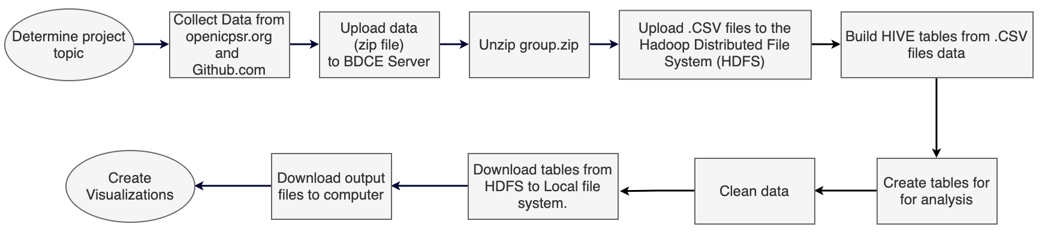
Workflow

Slide 6
The Dataset
Dataset Size: 5.58 Gigabytes
3 CSV Files:
Tweetid_sentiment file → Sentiment information: location, categories, date…
Covid19_case file → Covid19 case information: iso_code,continent,location,date,total_cases,new_cases, ...
World_vaccination file → Covid19 world vaccination: information: location, iso_code, date, total_vaccinations, ...
Total Output time to Create and Populate tables from RAW csv files in Hive:
~1 minutes

Slide 7

COIVD-19 Twitter Sentiment Analysis
Analysis 1 – Introduction
Goal:
Evaluate U.S. Twitter user’s sentiment on Covid-19 over time via Global Reactions to COVID-19 on Twitter (sentiment_category).
How:
Utilize Hadoop (HDFS), HIVE query language, and Excel-3D Maps.
Extract data from the ‘tweetid_sentiment’ file to create table
Create the 'tweet_sample' for small table for testing
Create 'tweet_cnt' table from ‘tweetid_sentiment’ table to count 'sentiment_category' field

Slide 8
Covid-19 Tweeter Sentiment Analysis
Analysis 1 – Output table
country | date | sentiment_category | cnt
United States | 1/28/2020 | negative | 2255
United States | 1/28/2020 | neutral | 485
United States | 1/28/2020 | positive | 487
United States | 1/28/2020 | very negative | 150
United States | 1/28/2020 | very positive | 11
Output file detail and performance:​
​Total Rows: 1,707​
File Size: 71.6KB​
Computation Time: 67.469 seconds​

Slide 9
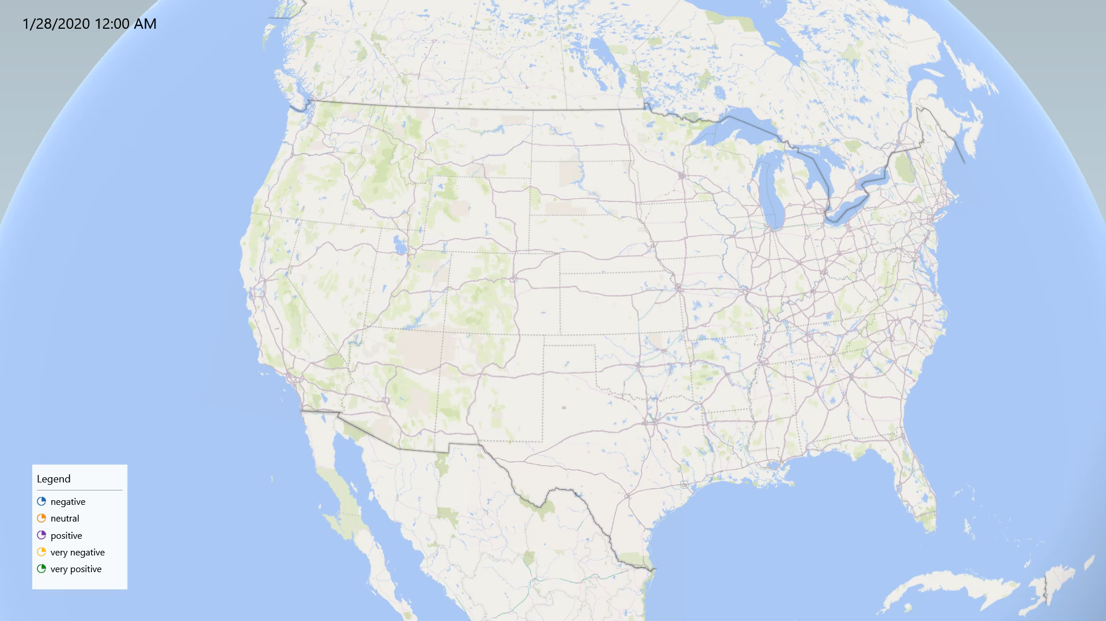
COIVD-19 Twitter Sentiment Analysis
Analysis 1 – 3D map analysis

Slide 10
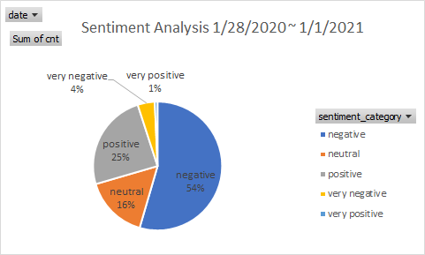
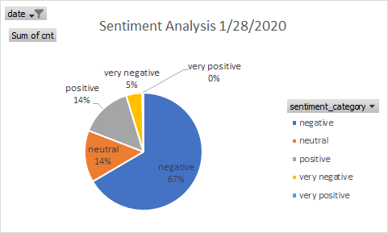
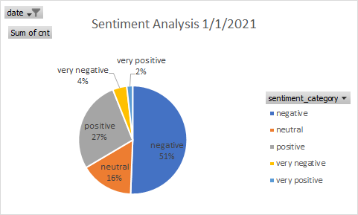
COIVD-19 Twitter Sentiment Analysis
Analysis 1 – Conclusion
Key Findings:
Overall sentiment breakdown in the United States from 1/28/2020 – 1/1/2021 is:
54% Negative,
6% Neutral
25% Positive
4% very negative
1% very positive
Interestingly, we see improvement in each sentiment metric over that span of time.
Sentiment_category, cnt(count(sentiment_category))

Slide 11
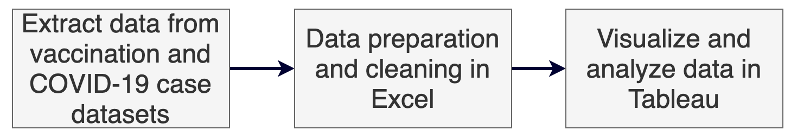
Vaccinations & New Cases
Introduction 2
Goal:
Analyze the relationship between the vaccination rate per hundred people and new cases of COVID-19 between 4/14/2021 to 4/23/2021
How:
Extract data from vaccination and COVID-19 cases dataset
Organize and clean data in excel
Use Tableau to visualize and analyze data

Slide 12
Vaccinations & New Cases
Analysis 2, 3, & 4 – Output table, Covid19_case_sampl1
iso_code | location | date | total_cases | new_cases | total_deaths | new_deaths | total_cases_per_million | new_cases_per_million | total_deaths_per_million | new_deaths_per_million | population
USA | United States | 4/13/2021 | 31345985 | 77878 | 563562 | 824 | 94700.1 | 235.279 | 1702.591 | 2.489 | 331002647
USA | United States | 4/14/2021 | 31421360 | 75375 | 564518 | 956 | 94927.82 | 227.717 | 1705.479 | 2.888 | 331002647
USA | United States | 4/15/2021 | 31495649 | 74289 | 565405 | 887 | 95152.26 | 224.436 | 1708.159 | 2.68 | 331002647
USA | United States | 4/16/2021 | 31575640 | 79991 | 566266 | 861 | 95393.92 | 241.663 | 1710.76 | 2.601 | 331002647
USA | United States | 4/17/2021 | 31628013 | 52373 | 566946 | 680 | 95552.15 | 158.225 | 1712.814 | 2.054 | 331002647
USA | United States | 4/18/2021 | 31670031 | 42018 | 567259 | 313 | 95679.086 | 126.942 | 1713.76 | 0.946 | 331002647
USA | United States | 4/19/2021 | 31737964 | 67933 | 567736 | 477 | 95884.32 | 205.234 | 1715.201 | 1.441 | 331002647
USA | United States | 4/20/2021 | 31799237 | 61273 | 568560 | 824 | 96069.44 | 185.113 | 1717.69 | 2.489 | 331002647
USA | United States | 4/21/2021 | 31862094 | 62857 | 569402 | 842 | 96259.336 | 189.899 | 1720.234 | 2.544 | 331002647
USA | United States | 4/22/2021 | 31929351 | 67257 | 570345 | 943 | 96462.52 | 203.192 | 1723.083 | 2.849 | 331002647
USA | United States | 4/23/2021 | 31991750 | 62399 | 571197 | 852 | 96651.04 | 188.515 | 1725.657 | 2.574 | 331002647
Output file detail and performance:​
​Total Rows: 833,868
File Size: 5,926 KB
Computation Time: 16.45 seconds

Slide 13
Vaccinations & New Cases
Analysis 2, 3, & 4 – Output table, world_vac_sample1
location | iso_code | date | total_vaccinations | people_vaccinated | people_fully_vaccinated | total_vaccinations_per_hundred | people_vaccinated_per_hundred | people_fully_vaccinated_per_hundred
United States | USA | 4/13/2021 | 192282781 | 122295530 | 75322283 | 57.49 | 36.57 | 22.52
United States | USA | 4/14/2021 | 194791836 | 123917385 | 76681252 | 58.24 | 37.05 | 22.93
United States | USA | 4/15/2021 | 198317040 | 125822868 | 78498290 | 59.3 | 37.62 | 23.47
United States | USA | 4/16/2021 | 202282923 | 127743096 | 80609818 | 60.48 | 38.2 | 24.1
United States | USA | 4/17/2021 | 205871913 | 129494179 | 82471151 | 61.56 | 38.72 | 24.66
United States | USA | 4/18/2021 | 209406814 | 131247546 | 84263408 | 62.61 | 39.24 | 25.2
United States | USA | 4/19/2021 | 211581309 | 132321628 | 85365180 | 63.26 | 39.56 | 25.52
United States | USA | 04-02-21 | 157606463 | 101804762 | 57984785 | 47.13 | 30.44 | 17.34
United States | USA | 4/20/2021 | 213388238 | 133266995 | 86223506 | 63.8 | 39.85 | 25.78
United States | USA | 4/21/2021 | 215951909 | 134445595 | 87592646 | 64.57 | 40.2 | 26.19
United States | USA | 4/22/2021 | 218947643 | 135791031 | 89245776 | 65.47 | 40.6 | 26.68
United States | USA | 4/23/2021 | 222322230 | 137234889 | 91175995 | 66.48 | 41.03 | 27.26
United States | USA | 4/24/2021 | 225640460 | 138644724 | 93078040 | 67.47 | 41.46 | 27.83
United States | USA | 04-03-21 | 161688422 | 104213478 | 59858146 | 48.35 | 31.16 | 17.9
United States | USA | 04-04-21 | 165053746 | 106214924 | 61416536 | 49.35 | 31.76 | 18.36
Output file detail and performance:​
​Total Rows: 14,582
File Size: 692 kb
Computation Time: 12.627 seconds

Slide 14
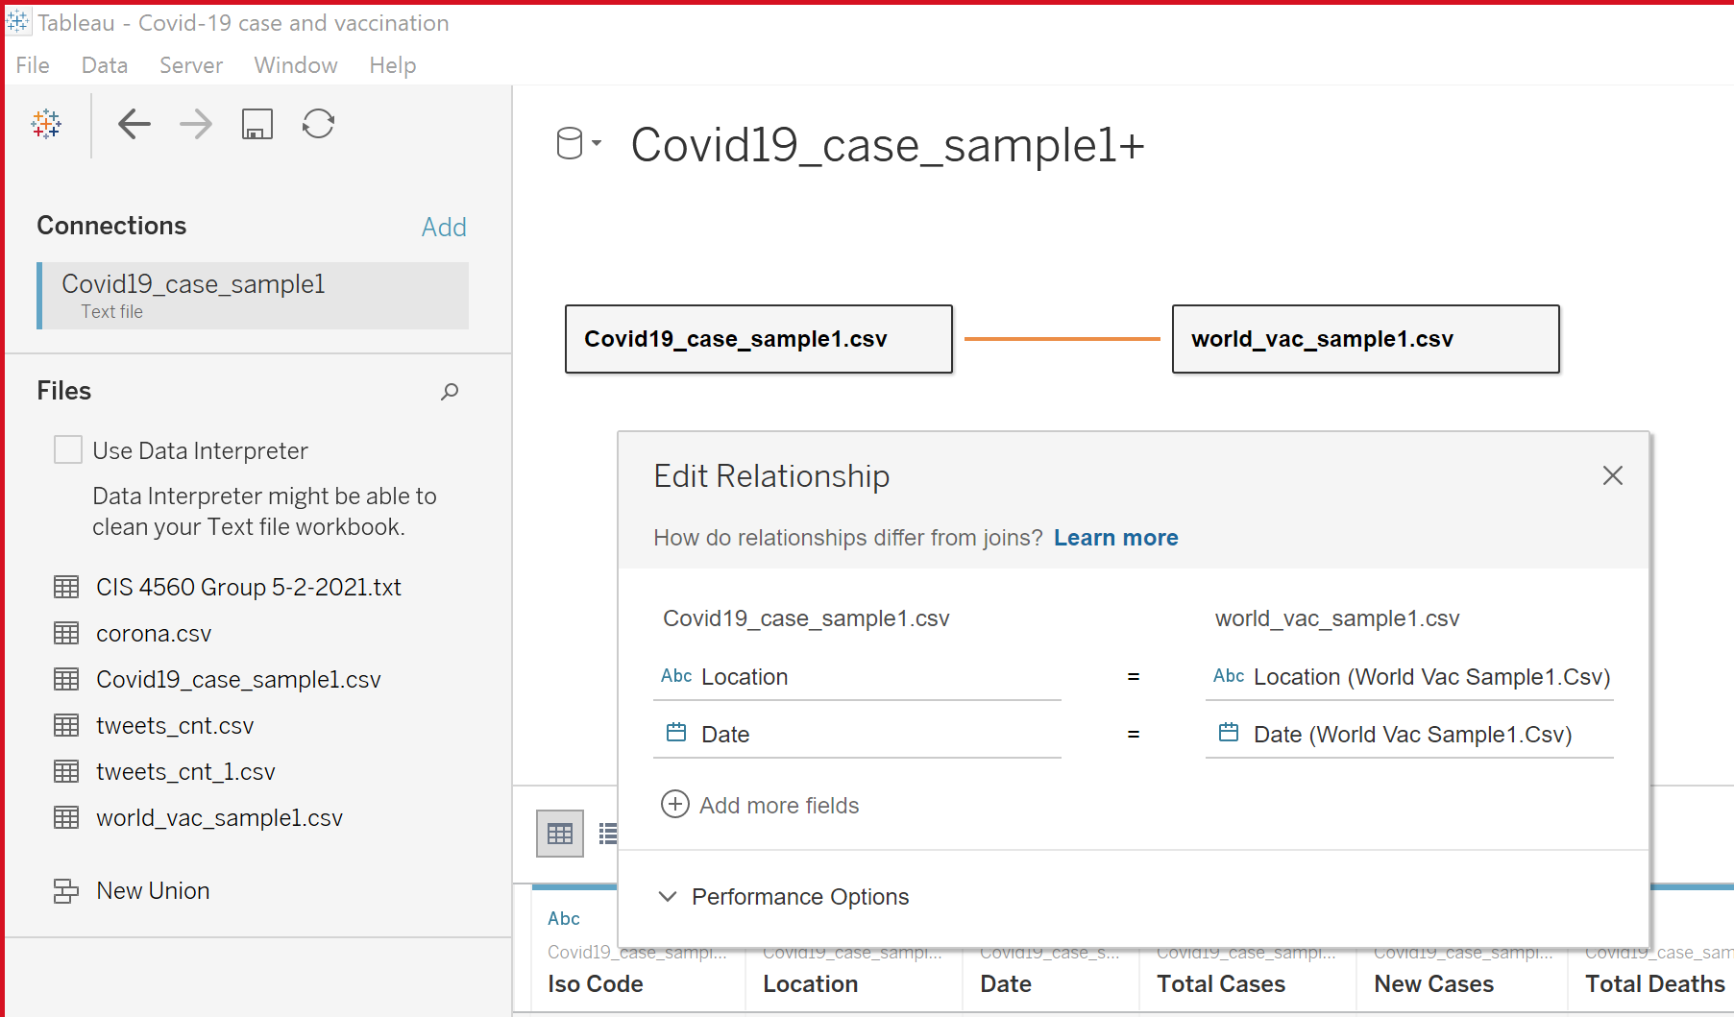
ADD Tableau relationship
Analysis 2, 3, & 4 – Output table, Covid19_case_sampl1
In order to visualize the data from the covid19_case_sample1.csv and world_vac_sample1.csv, our team used Tableau’s relationship function in order to link the two datasets together.
We connected Location and Date of both datasets with each other.

Slide 15
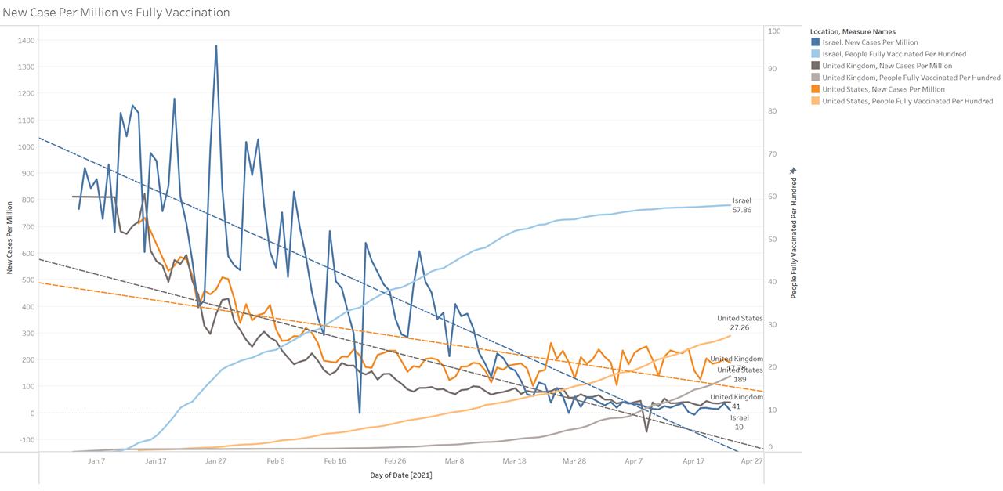
COVID-19 New Cases & Vaccinations
Analysis 2 – New Cases per Million & Vaccinations
People Fully Vaccination rate
Israel: 57.86%
United States: 27.26%
United Kingdom: 17.78
New Case Per Million
Israel: 10
United States: 27.26
United Kingdom: 41
Notes:
This line chart shows fully vaccinated people per hundred people in a lighter color than daily cases per million people in a darker color.
Israel has the highest full vaccination rates at 57 people vaccinated per 100 people. Next is the United States at 27 people per 100, after that is the United Kingdom at 17 people per 100. These rates are all increasing.
The United States has 189 new cases per million, the United Kingdom has 41 new cases per million, and Israel has ten new cases per million. These rates are all decreasing.

Slide 16
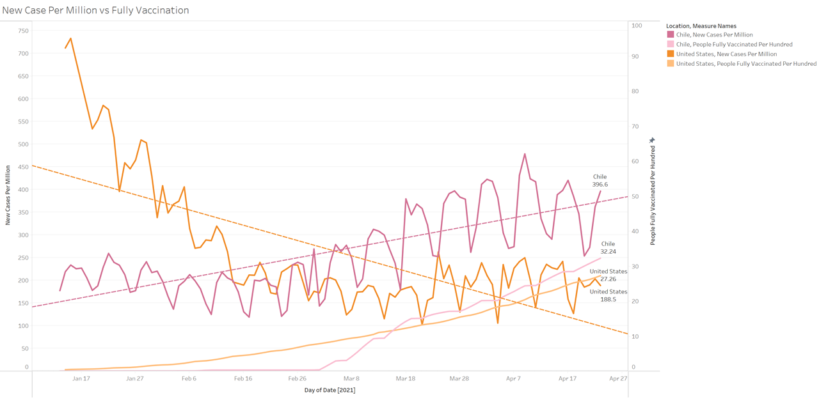
COVID-19 New Cases & Vaccinations
Analysis 2 – Chile vs the United States
People Fully Vaccination rate
Chile: 32.24%
United States: 27.26%
New Case Per Million
Chile: 396.6
United States: 27.26
Notes:
Despite the rising vaccination rates in Chile, cases per million continue to rise throughout the year. At the start of the year Chile had around 175 cases per million but by late April its increased to 396 cases per million. Meanwhile Chile’s vaccination rate climbed to 32 people per hundred.
Unlike the other countries who have vaccinated their population such as the United States, there is a positive relationship between vaccinations and new cases in Chile.
There are many different factors to effect on COVID-19 new cases, and Chile is using Chinese vaccines that imply some of brand vaccine is not working.

Slide 17
Vaccinations & New Cases
Analysis 2 – Conclusion
Key Findings:
New cases generally decline as more people are vaccinated, however, there are many elements may contribute to increase in new cases.
For example, new cases in Chile did not decline as vaccinations rolled out.
Dimension: Day(Date)
Measure: SUM(New Cases Per Million), SUM(People fully vaccination)
Filtered by 12/20/2020 ~ 4/23/2021

Slide 18
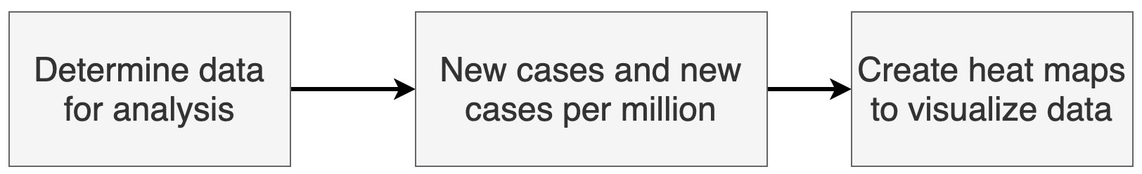
Covid-19 New Cases
Analysis 3 - Introduction
Goal:
Identify where COVID-19 is spreading the most in the world.
Compare analyzing new cases by raw numbers and new cases per million
How:
Utilize Tableau to create a global heatmap.
Color data scales by severity of COVID-19 outbreak; the more cases the darker the color.

Slide 19
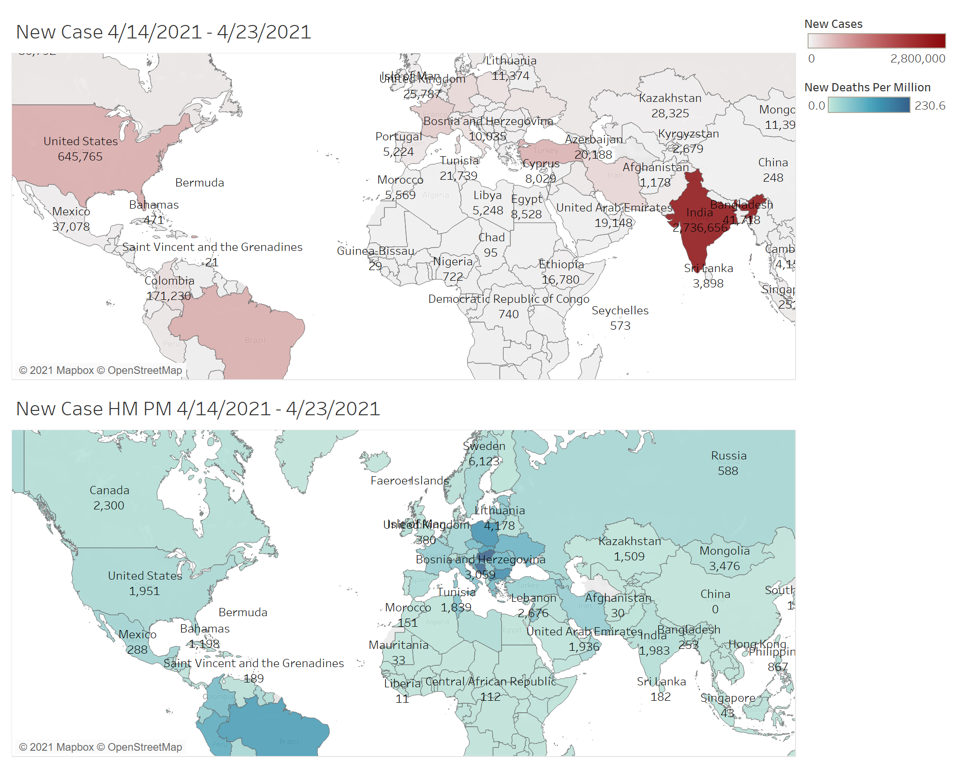
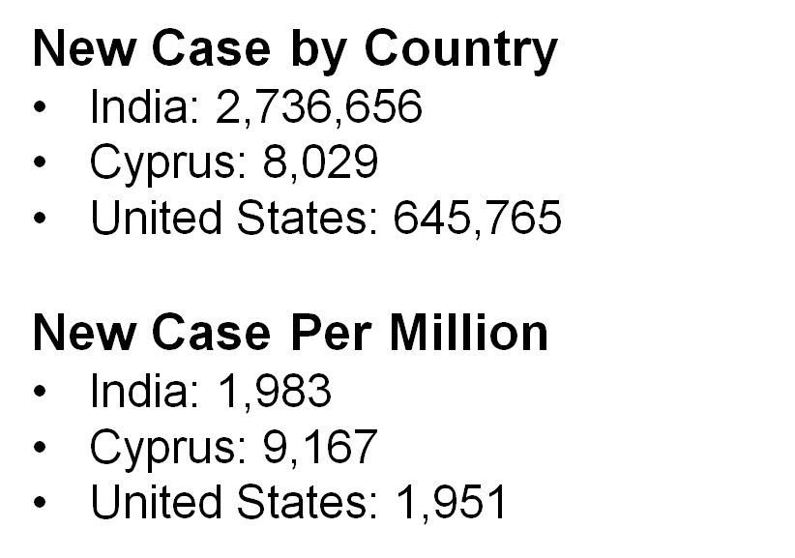
Covid-19 New Cases per Million
Analysis 3 – Heatmap

Slide 20
Covid-19 New Cases
Analysis 3 – Conclusion
Key Findings:
The total new case showed India the highest number of cases, however, new case per million showed that many countries have higher new cases than India between 4/14/2021 to 4/23/2021.
Dimension: Location
Measure 1: SUM(New Cases)
Measure 2: SUM(New Cases Per Million)

Slide 21
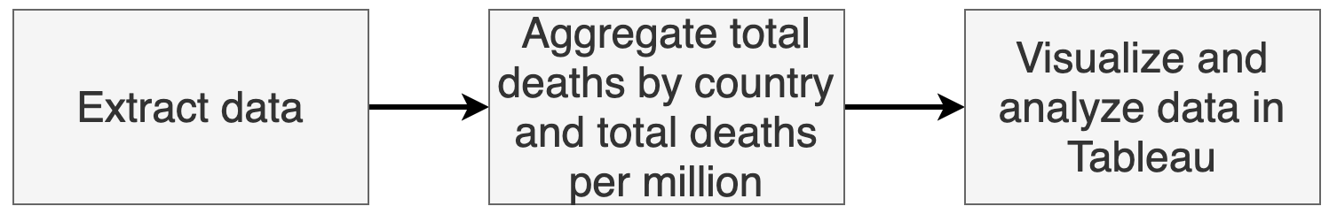
COVID-19 Total Deaths
Introduction 4
Goal:
Identify COVID-19 fatalities .
Compare analyzing total deaths by raw numbers and new cases per million
How:
Utilize Tableau to create a global heatmap.
Color data scales by severity of COVID-19 outbreak; the more deaths the darker the color.
Notes:
Likely to be Cut

Slide 22
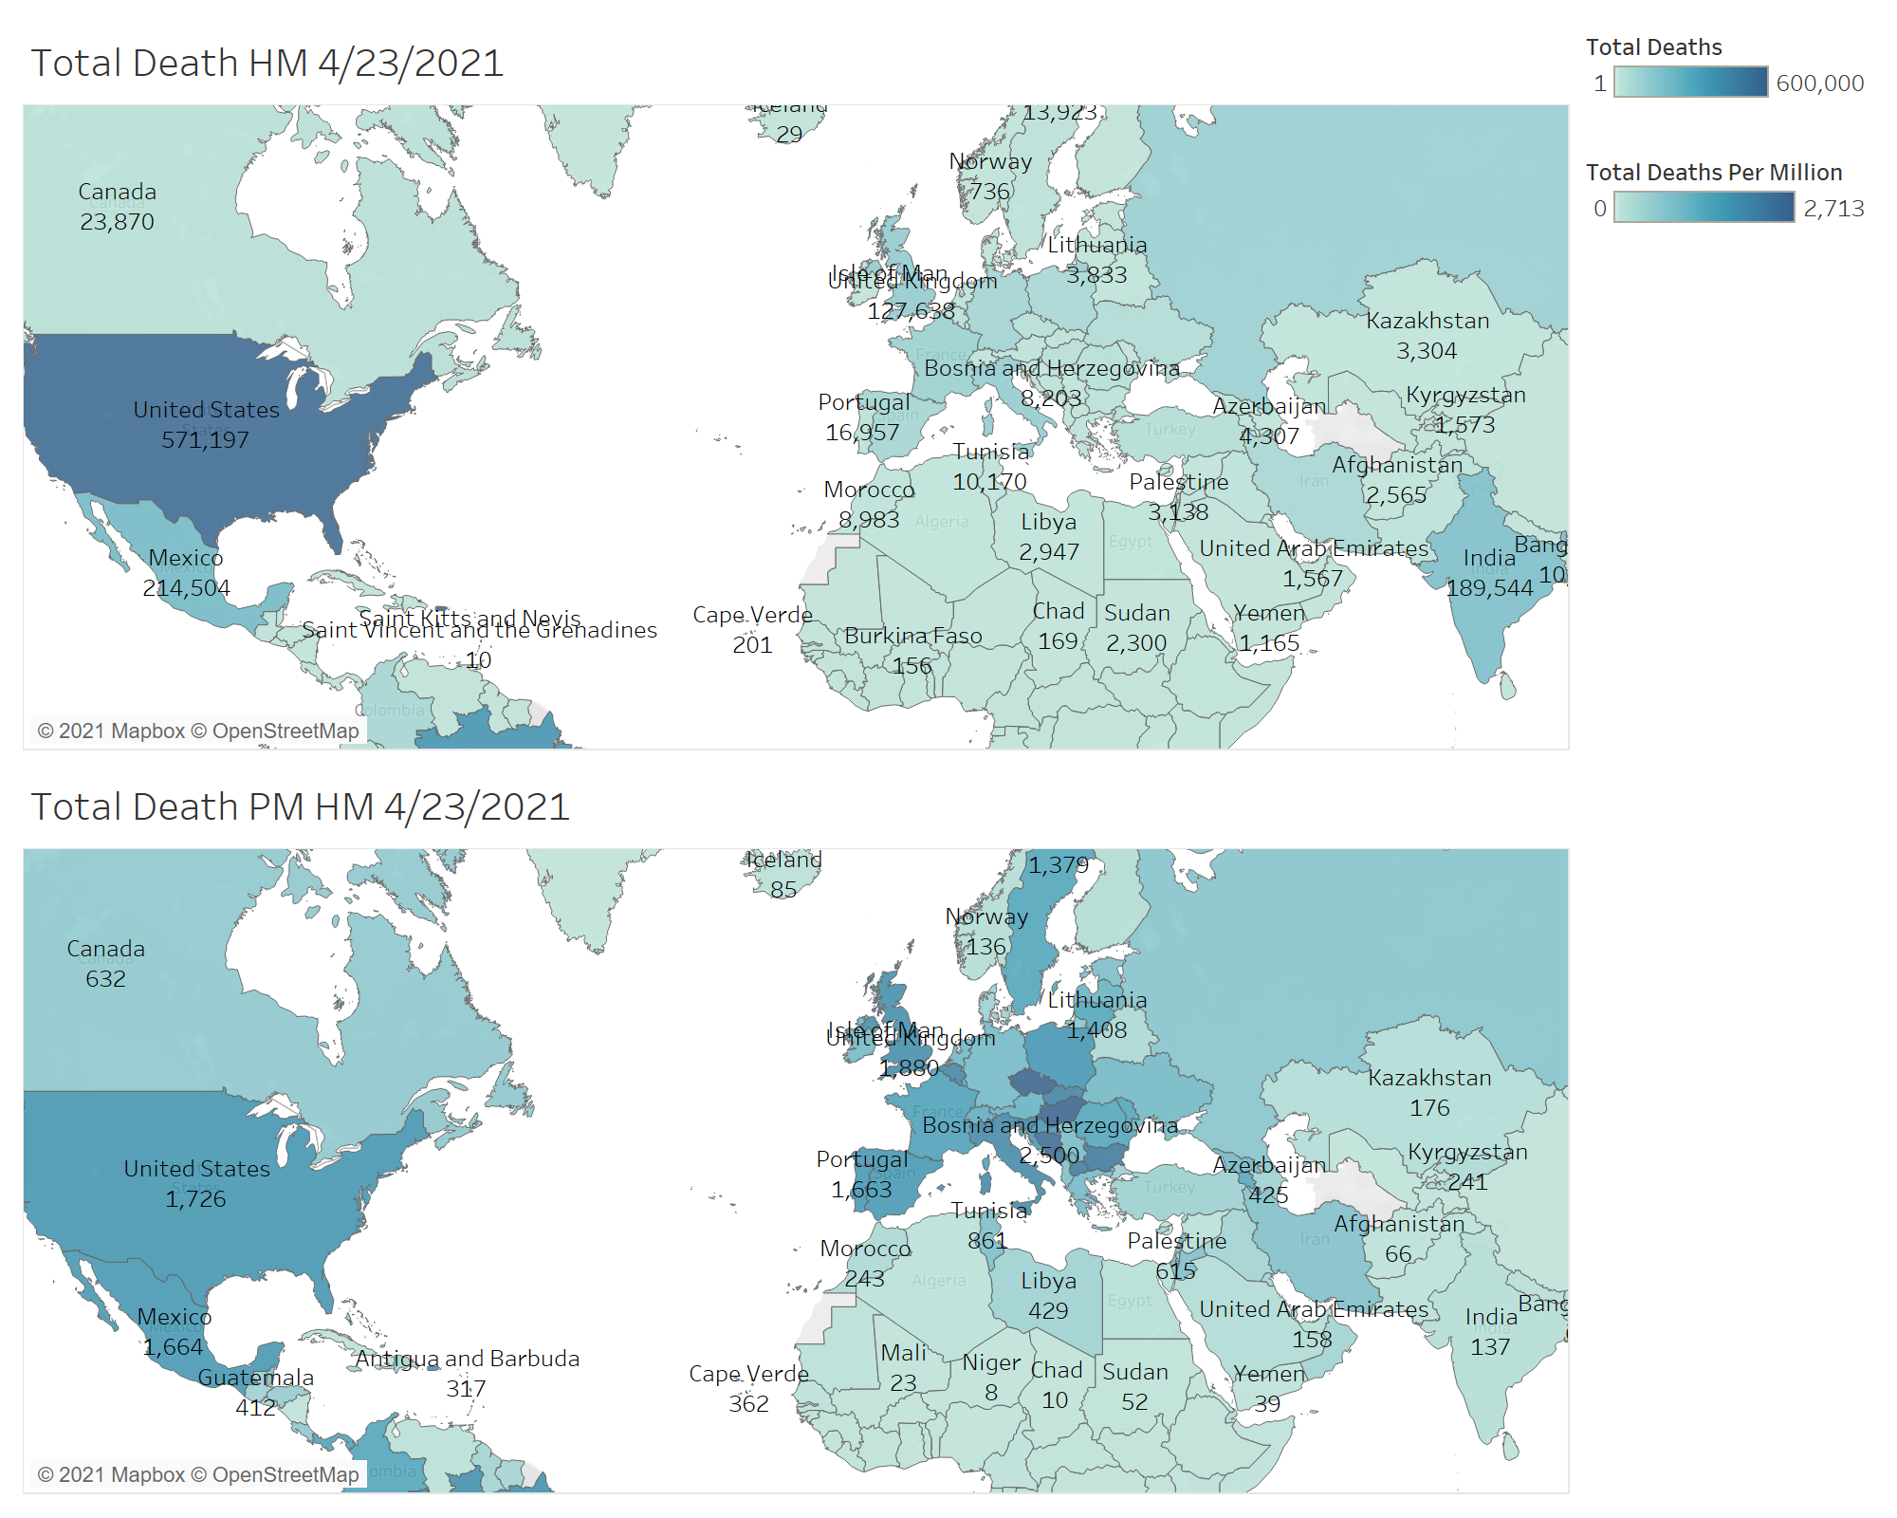
Total Deaths
Analysis 4 – Total Death Heat Map
Total Death by Country
India: 189,544
United States: 571,197
Hungary: 26,208
Total Death Per Million
India: 137
United States: 1,726
Hungary: 2,713
Notes:
Likely to be Cut

Slide 23
Total Deaths
Analysis 4 – Conclusion
Key Findings:
The total death showed the United State is the highest as 571,197, however, Hungary is the highest as 2,713 in total death per million.
Dimension: Location
Measure 1: SUM(Total Death)
Measure 2: SUM(Total Death Per Million)
Filtered by 4/23/2021
Notes:
Likely to be Cut

Slide 24
Questions?

